Slide 1

Stack Overflow Developer Survey
Ika Wahyuni
October 11/2025

Slide 2

OUTLINE
Executive Summary
Introduction
Methodology
Results
Visualization – Charts
Dashboard
Discussion
Findings & Implications
Conclusion
Appendix

Slide 3

EXECUTIVE SUMMARY
Deep dive into technology usage based on:
Current usage
Future usage
Demographics

Slide 4

INTRODUCTION
Initiative by collecting data from diverse sources and identifying trends for this year's report on in-demand skills.
One key source for this analysis will be the latest Developer Survey, a comprehensive dataset offering insights into the global developer community.
The initial task is to gather data on the most sought-after programming skills from various sources, including:
1. Job postings
2. Training portals
3. Developer surveys, such as the latest Stack Overflow Developer Survey

Slide 5

METHODOLOGY
1. Scraping internet websites
2. Accessing APIs, and working with datasets like the latest Stack Overflow Developer Survey in various formats such as .csv files, Excel sheets, and databases.
3. After gathering the data, we will apply data-wrangling techniques to prepare the data for analysis
4. After the data is prepared, we employ statistical techniques to analyze the data, identifying key trends and insights
5. Last, data visualization using IBM Cognos Analytics

Slide 6
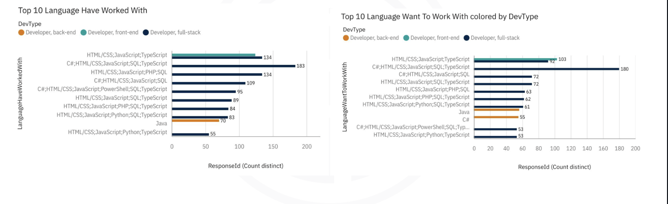
PROGRAMMING LANGUAGE TRENDS
Current Year
Next Year

Slide 7
PROGRAMMING LANGUAGE TRENDS - FINDINGS & IMPLICATIONS
Findings
Javascript top trending
SQL 2nd runner up
CSS 3rd place
Implications
Javascript is expected to continue its dominant position
SQL continues to remain relevant
Good to know some CSS

Slide 8
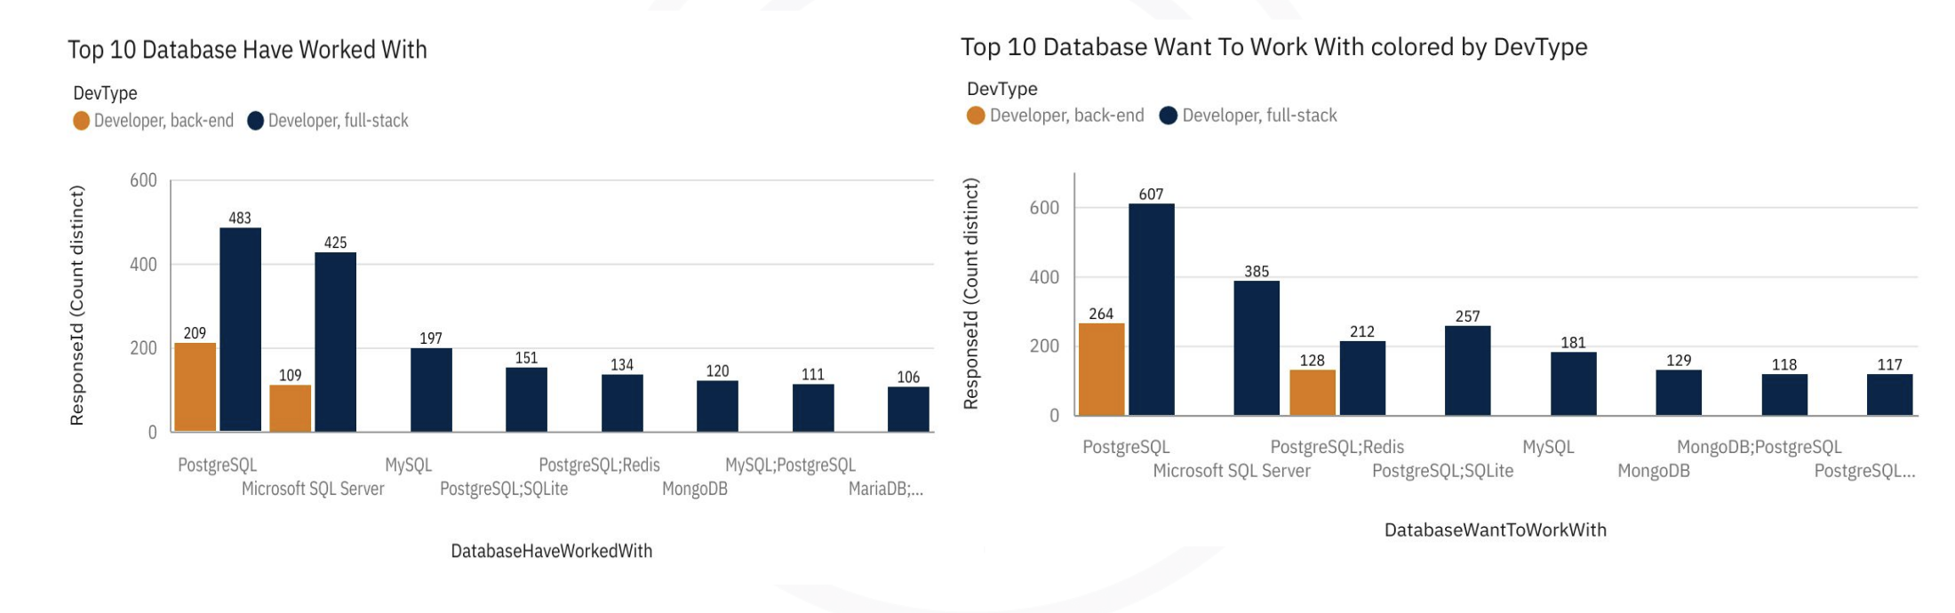
DATABASE TRENDS
Current Year
Next Year

Slide 9
DATABASE TRENDS - FINDINGS & IMPLICATIONS
Findings
Postgres top trending
MySQL 2nd runner up
Redis 3rd place
Implications
Postgres is expected to continue its dominant position
MYSQL continues to remain relevant
Good to know some Redis

Slide 10

DASHBOARD

Slide 11
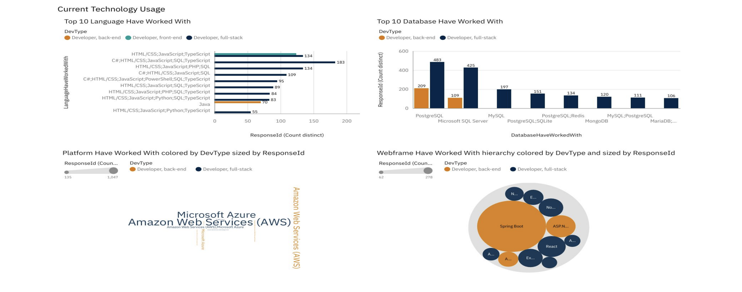
DASHBOARD TAB 1

Slide 12
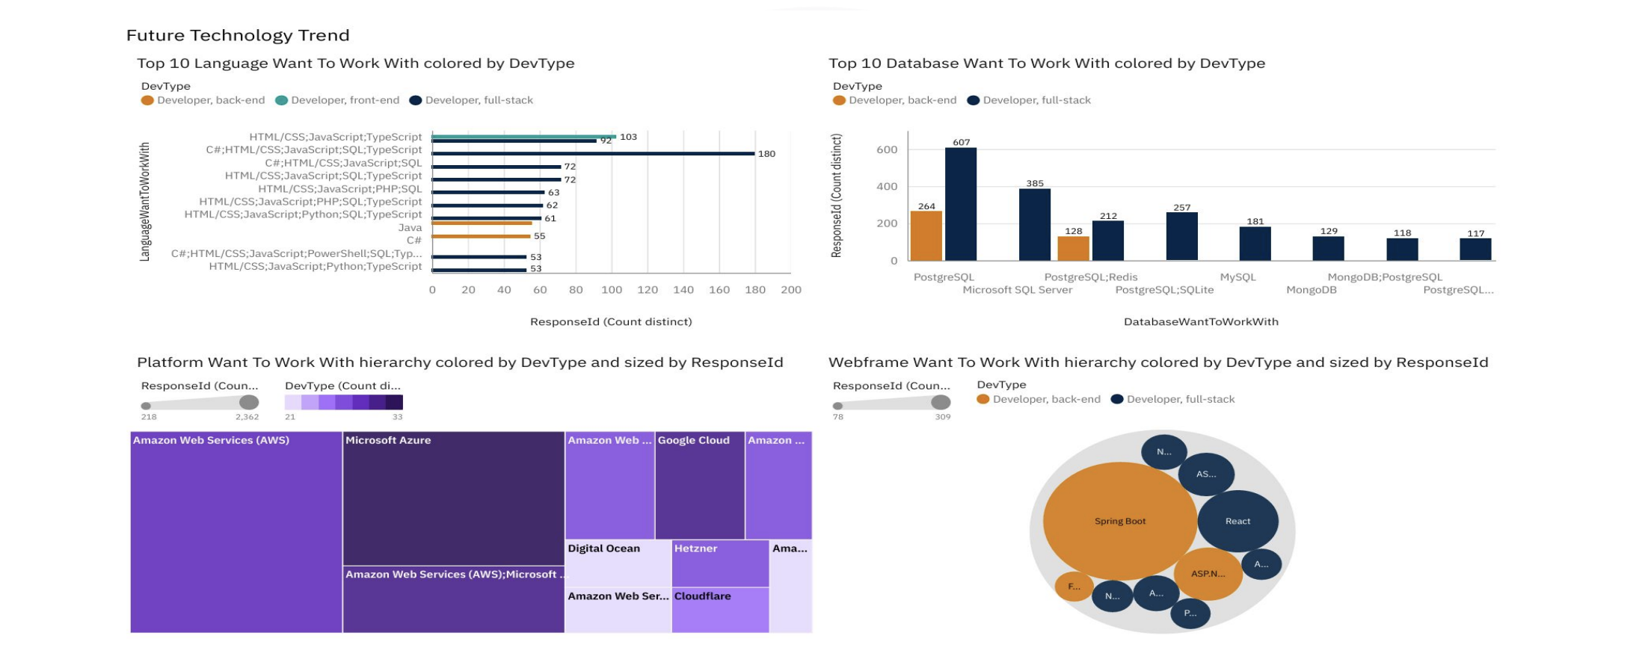
DASHBOARD TAB 2

Slide 13
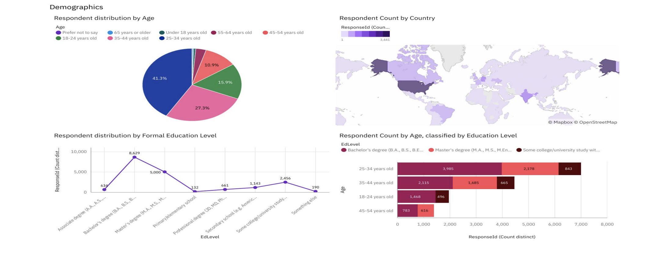
DASHBOARD TAB 3
Screenshot of dashboard tab 3 goes here

Slide 14
DISCUSSION
For the future, focus:
Javascript
SQL
CSS
Postgres
MySQL
Redis
AWS
Spring Boot

Slide 15
OVERALL FINDINGS & IMPLICATIONS
Findings
• Javascript
•Postgres
•AWS
Implications
•Dominant language to learn
•Dominant database to learn
•Dominant platform to learn

Slide 16

CONCLUSION
The key takeaway from the research
based on the survey are the following:
○ Current trends
○ Future trends
○ What technologies to focus on
(Javascript, Postgres, SQL, AWS etc
etc)
○ Demographics are important too

Slide 17

APPENDIX
Include any relevant additional charts, or tables that you may have created during the analysis phase.

Slide 18
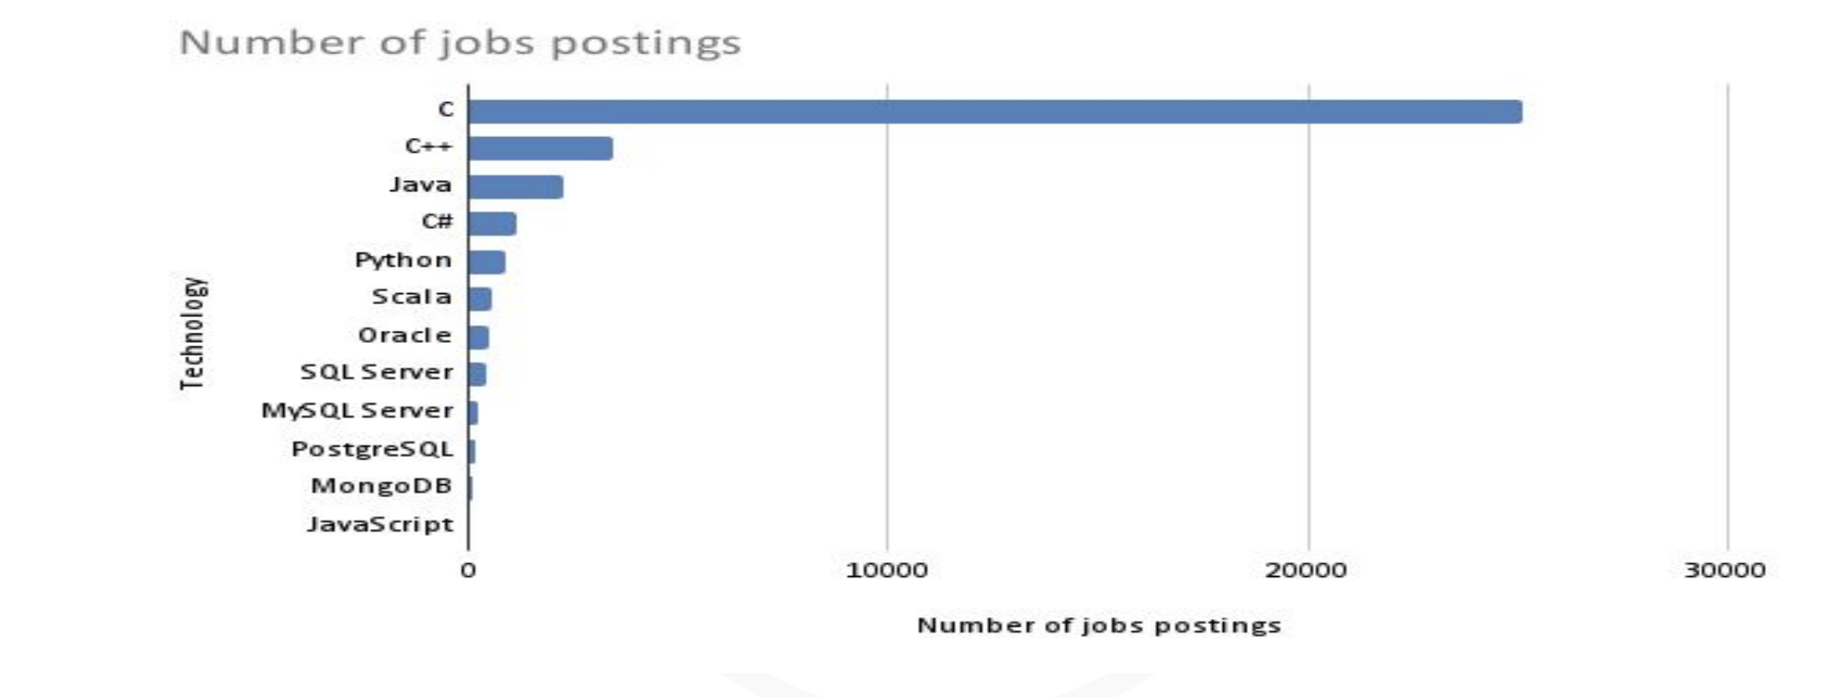
JOB POSTINGS

Slide 19
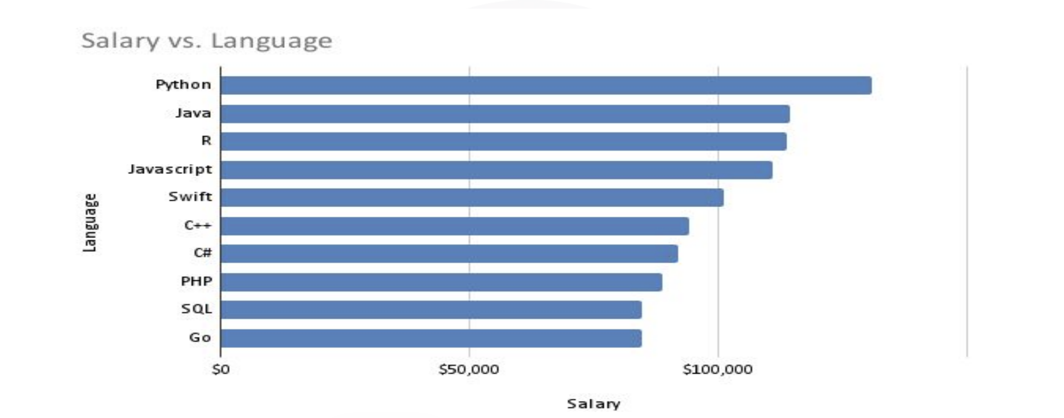
POPULAR LANGUAGES

